Slide 1


Slide 2
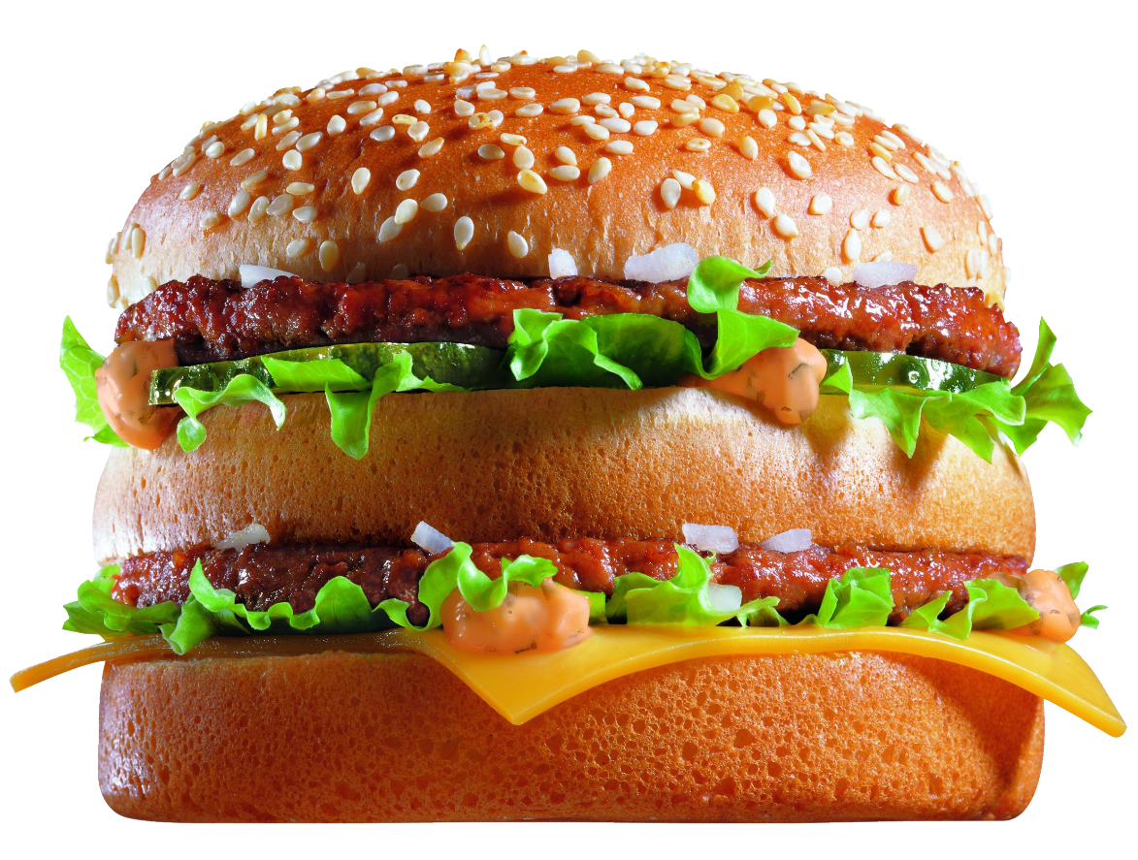
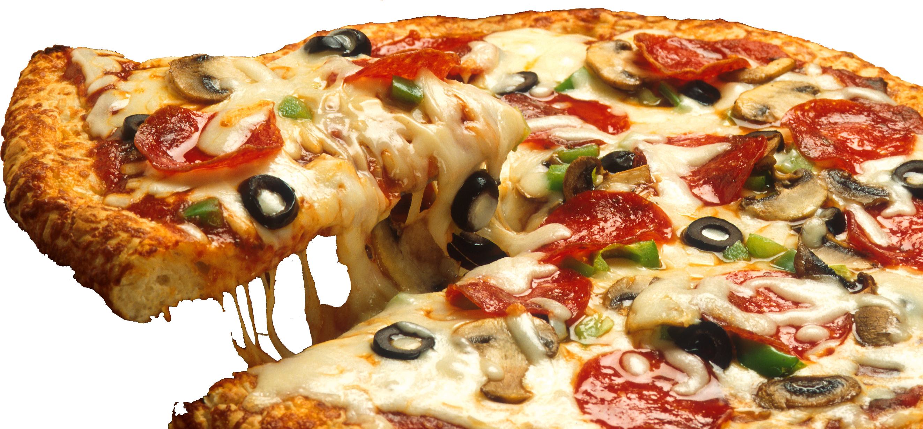

What do you see?

Slide 3
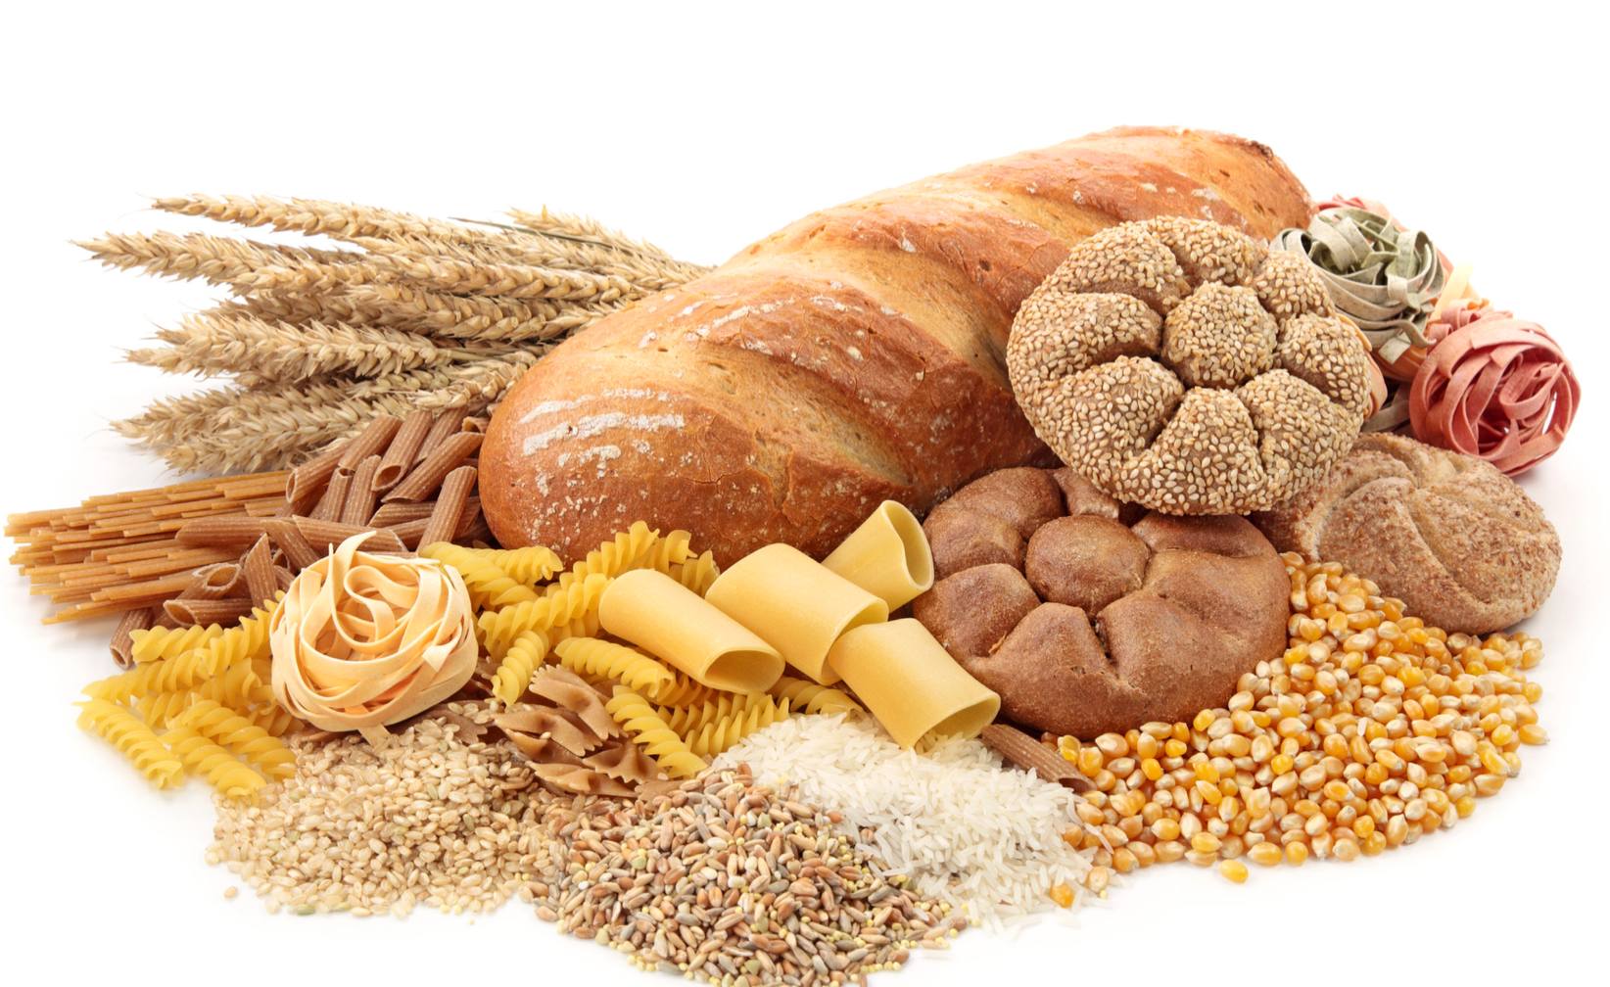
What are carbohydrates?

Slide 4
What are carbohydrates
High carbohydrates diet results to fast aging

Slide 5
CASE STUDY

